Slide 1
Projekt
Präsentation

Slide 2
Agenda zur leichten Orientierung
Pain
Solution
< />
Showcase

Slide 3
Aufbau Leitfaden
Pain
Solution
Technical Details
Showcase
< />
Zeig mal her!
Welches Problem löst meine Software?
Was macht meine Software?
Kurze darstellung der Ausgangssituation. Macht dem Zuhörer verständlich, was ohne eurer Software nicht möglich ist.
Erklärt, wie eure Software das Problem zu lösen versucht.
Geht auf technische Details ein. Welche Technologien kommen zum Einsatz? Wie habt ihr die interessanten Dinge gelöst?
Auch wenn es bisher schon Screenshots gab, jetzt wollen wir das Ding live sehen!

Slide 4
Konzept Theorie (bsp. Sass/Less)
Sass is completely compatible with all versions of CSS. We take this compatibility seriously, so that you can seamlessly use any available CSS libraries.
Over and over again, the industry is choosing Sass as the premier CSS extension language.
Sass boasts more features and abilities than any other CSS extension language out there. The Sass Core Team has worked endlessly to not only keep up, but stay ahead.
Sass is actively supported and developed by a consortium of several tech companies and hundreds of developers.
Sass has been actively supported for over 13 years by its loving Core Team.
There are an endless number of frameworks built with Sass. Compass, Bourbon, and Susy just to name a few.

Slide 5
Konzept Theorie (bsp. Sass/Less)
“CSS Upgrade”
Erweitert CSS um praktische Funktionen
Kompiliert
Ergebnis wird in eine .css Datei kompiliert
Sass / Less
Die beiden relevanten Vertreter

Slide 7
Konzept in echt
@appColor: #C19B76;
@images: "../img";
.background-image-mixin(@url){
background-image: url(@url);
background-size: contain;
background-repeat: no-repeat;
background-position: center center;
}
#app_header{
background-color: @appColor;
.logo{
Background-image: ("@{images}/logo.png");
width: 100px;
height: 100px;
}
}
#app_header {
background-color: #C19B76;
}
#app_header .logo {
background-image: url("../img/logo.png");
background-size: contain;
background-repeat: no-repeat;
background-position: center center;
width: 100px;
height: 100px;
}

Slide 8
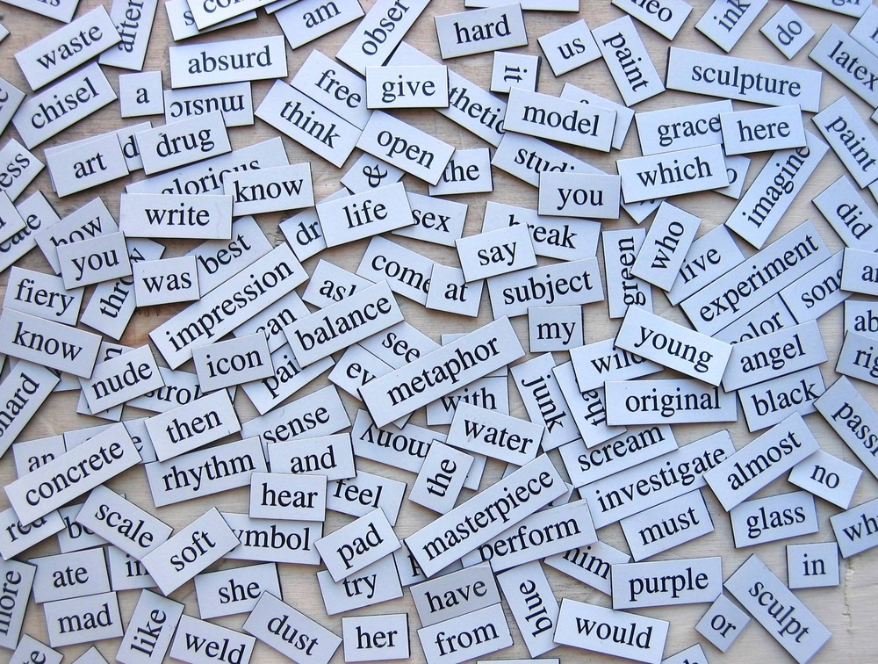
>
True or false?

Slide 9
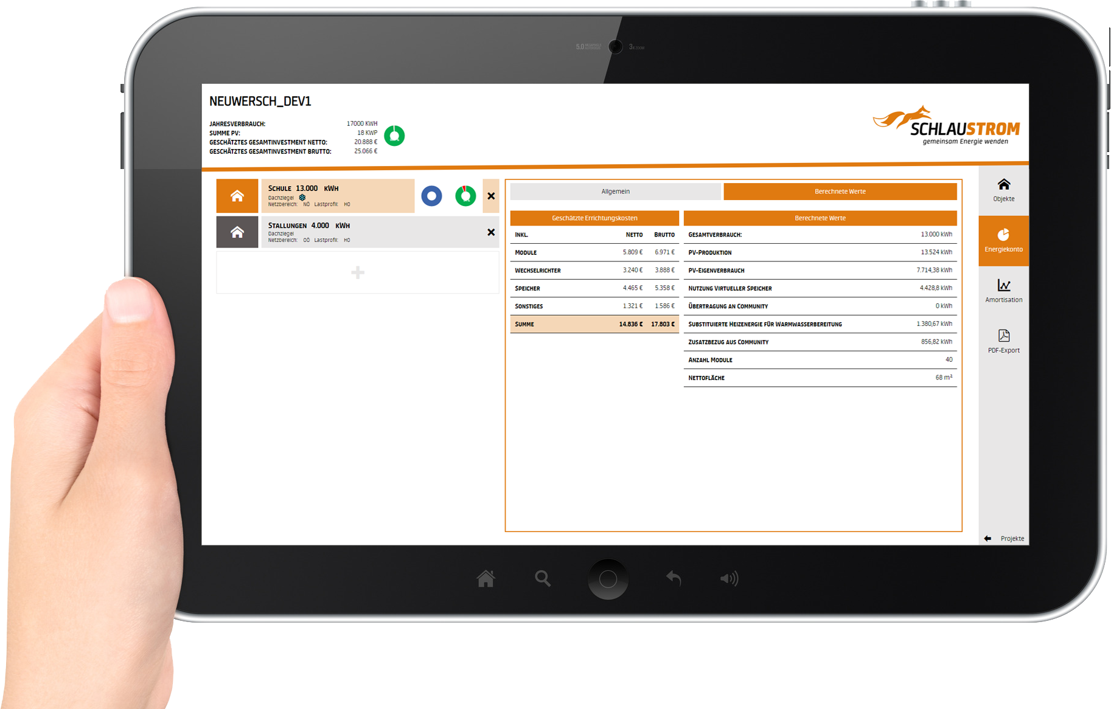
Showcase

Slide 10
Questions?

